Slide 1


Hypothesis Testing
Part ‭Ⅱ

Slide 2
Table of Contents
PartⅠ
Definition of Hypothesis
Steps in Hypothesis Testing
One Sample T-test
Two Sample T-test
Part ‭Ⅱ
Chi-Square Test
Paired Sample T-test
ANOVA

Slide 3
Table of Contents
PartⅠ
Definition of Hypothesis
Steps in Hypothesis Testing
One Sample T-test
Two Sample T-test
Part ‭Ⅱ
Chi-Square Test
Paired Sample T-test
ANOVA
Todays Topic

Slide 4
Chi-Square
Distribution

Slide 5
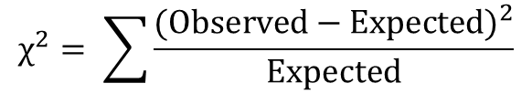
Hypothesis testing
Chi-square Test
Chi-square test of independence, also called the chi-square test of association, is a statistical method for determining the relationship between two variables that are categorical.
It determines if there is a substantial difference between the observed and expected data. By comparing the two datasets, we can determine whether the variables have a logical association.
$$χ^{2}= \sum{\frac{{(Observed−Expected)}^{2}}{Expected}}$$

Slide 6

Hypothesis testing
Chi-square Test
Example: Handedness and nationality
Contingency table of the handedness of a sample of Americans and Canadians.
A chi-square test (a test of independence) can test whether these observed frequencies are significantly different from the frequencies expected if handedness is unrelated to nationality.
Notes:
Null hypothesis (H₀): The proportion of people who are left-handed is the same for Americans and Canadians.
Alternative hypothesis (H_{A}): The proportion of people who are left-handed differs between nationalities.

Slide 7
Two Sample
Distributions

Slide 8
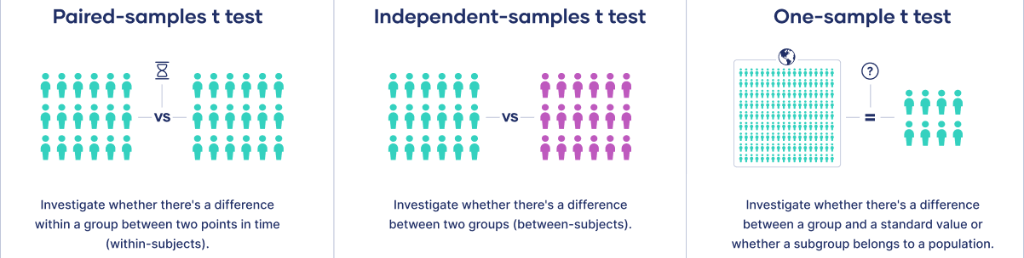
Hypothesis testing
One-sample, two-sample, or paired T-test:
If the groups come from a single population (e.g., measuring before and after an experimental treatment), perform a paired sample T-test.
If the groups come from two different populations (e.g., two different species, or people from two separate cities), perform a two-sample T-test(a.k.a. independent t test).
If there is one group being compared against a standard value (e.g., comparing the acidity of a liquid to a neutral pH of 7), perform a one-sample T-test.

Slide 9
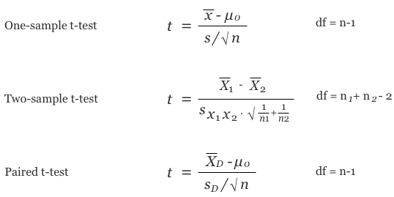
Hypothesis testing
T-Test formula:

Slide 10
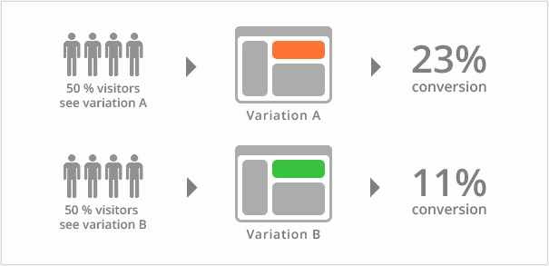



Hypothesis Testing
Different Types of Tests
Two Sample T-test (compares the means of two independent samples)
in python: ttest_ind(sample1, sample2, alternative = “two-sided”)
○
in python: ttest_ind(sample1, sample2, alternative = “greater”)
○
in python: ttest_ind(sample1, sample2, alternative = “less”)

Slide 11
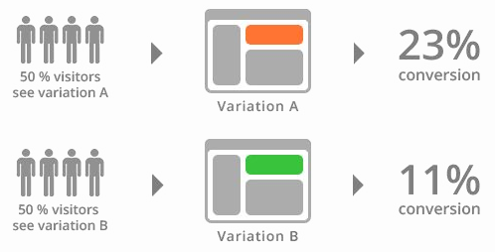
Hypothesis Testing
Different Types of Tests
Two Sample T-test (compares the means of two independent samples)

Slide 12
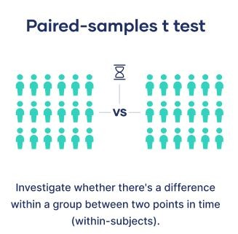
Hypothesis Testing
Different Types of Tests
Paired Sample T-test (compares the means of two dependent samples)
in python: ttest_rel(sample1, sample2, alternative = “two-sided”)
○
in python: ttest_rel(sample1, sample2, alternative = “greater”)
○
in python: ttest_rel(sample1, sample2, alternative = “less”)

Slide 13
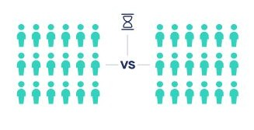
Hypothesis Testing
Different Types of Tests
Paired Sample T-test (compares the means of two dependent samples)
Investigate whether there’s a difference within a group between two points in time
(within-subjects)

Slide 14

Hypothesis Testing
Different Types of Tests
ANOVA (compares the means of multiple independent samples)
in python: f_oneway(sample_1, sample_2, sample_3, …, sample_n)

Slide 15
Summary
Hypothesis Testing:
- Create H0 and H1
- Pick a significance level: how confortable are we in being wrong
- Test Statics + get the pvalue
- If the pvalue is too smal, I reject H0

Slide 16
To be
Continued

